Slide 1
Discussion Unit:
DSE Bulk Loader
Introduce the DSE Bulk Loader
Notes:
The goal of this Discussion Unit is to demonstrate use and develop understanding of the DSE Bulk Loader.

Slide 2
Discussion Lab:
Bulk Loader versus Custom Client Side Program-
Notes:
On the next page we enter a Discussion Lab.

Slide 3




Discussion Lab: Bulk Load, or Custom Program ?
PreparedStatement
Parser
Multi-statement
Q Optimizer
Transaction/Batch
(Memory management)
Q Processor
(Restart on failure)
(Run time)
(Issues w/ data)
Client
Server
Notes:
Matching pairs Discussion Lab: SQL, CQL, DSE Java Driver
Match the attributes on the right with the objects on the left.

Slide 4
End of Discussion Lab:
Notes:
End of Discussion Lab-

Slide 5

DSBulk: Overview
Load, unload
CSV, JSON
Linux, Windows
File, directories, stdin/stdout, Web Url
2-3 times faster than CQLSH/COPY
Secure, Kerberos, other
Configurable data parsing
Command line
Tunable
Notes:
DSBulk offers the features listed above.
Download, version 1.1.0, 22 MB.
Reference Urls,
Doc home, https://docs.datastax.com/en/dsbulk/doc/index.html
Download, http://downloads.datastax.com/dsbulk/
Other loaders, https://academy.datastax.com/all-downloads#dl-enterprise

Slide 6
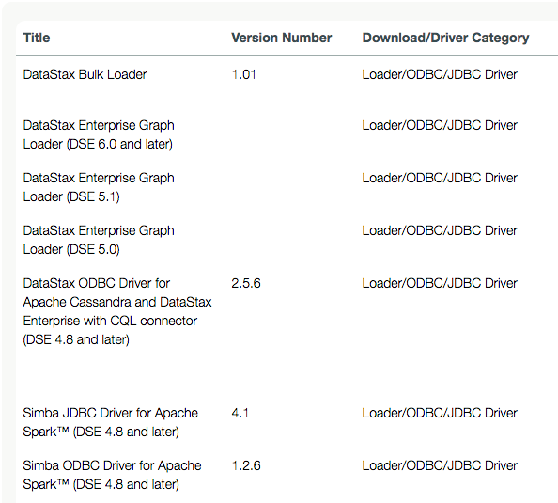
DSBulk: One of many loaders
Notes:
There are multiple loaders when using DSE. Minus the Graph Loader which currently has features not in DSBulk, DSBulk should be the loader to use moving forward.

Slide 7
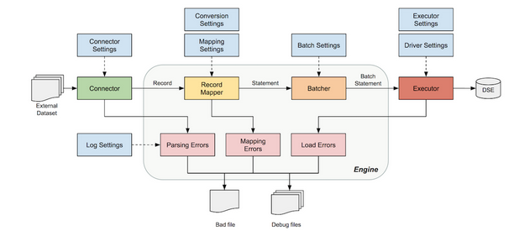
DSBulk: Loading Workflow
Notes:
Regarding DSBulk workflow for loading-
Configuration: The engine collects user-supplied settings, merges them with default values and configures the loading/unloading operation to run.
Connection: The engine handles the driver connection to DSE and manages driver-specific settings, as well as supports authentication and SSL encryption.
Conversion: The engine handles data type conversions, e.g. boolean, number, date conversions from anything (typically, strings or raw bytes as emitted by a connector) to appropriate internal representations (typically, Java Temporal or Number objects). It also handles NULL and UNSET values.
Mapping: The engine analyzes metadata gathered from the driver and infers the appropriate INSERT or SELECT prepared statement, then checks this information against user-supplied information about the data source, to infer the bound variables to use.
Monitoring: The engine reports metrics about all its internal components, mainly the connector and the bulk executor.
Error Handling: The engine handles errors from both connectors and the bulk executor, and reports read, parse, and write failures. These are redirected to a configurable "bad file" that contains sources that could not be loaded.

Slide 8
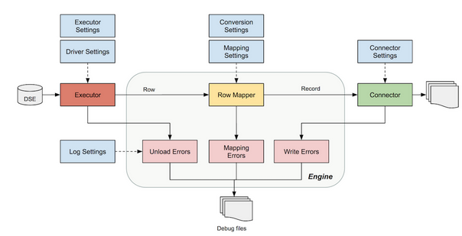
DSBulk: Unloading Workflow
Notes:
Regarding DSBulk workflow for un loading-
Configuration: The engine collects user-supplied settings, merges them with default values and configures the loading/unloading operation to run.
Connection: The engine handles the driver connection to DSE and manages driver-specific settings, as well as supports authentication and SSL encryption.
Conversion: The engine handles data type conversions, e.g. boolean, number, date conversions from anything (typically, strings or raw bytes as emitted by a connector) to appropriate internal representations (typically, Java Temporal or Number objects). It also handles NULL and UNSET values.
Mapping: The engine analyzes metadata gathered from the driver and infers the appropriate INSERT or SELECT prepared statement, then checks this information against user-supplied information about the data source, to infer the bound variables to use.
Monitoring: The engine reports metrics about all its internal components, mainly the connector and the bulk executor.
Error Handling: The engine handles errors from both connectors and the bulk executor, and reports read, parse, and write failures. These are redirected to a configurable "bad file" that contains sources that could not be loaded.

Slide 9
DSBulk: Simple Loading/Unloading
dsbulk unload -url myData.csv -k ks1 -t table1
dsbulk load -url export.csv -k ks1 -t table1 -h \
'10.200.1.3, 10.200.1.4' -header true
dsbulk load -url https://svr/data/export.csv -k ks1 -t table1 -h \
'10.200.1.3, 10.200.1.4' -port 9876
cat abc.csv | dsbulk load -url stdin:/ -k ks1 -t table1
Notes:
Examples of simple loading, unloading using DSBulk.
Reference Urls,
https://docs.datastax.com/en/dsbulk/doc/dsbulk/getStartedDsbulk.html

Slide 10
DSBulk: Load/Unload w/ config file
############ MyConfFile.conf ############
dsbulk {
# The name of the connector to use
connector.name = "csv"
# CSV field delimiter
connector.csv.delimiter = "|"
# The keyspace to connect to
schema.keyspace = "myKeyspace"
# The table to connect to
schema.table = "myTable"
# The field-to-column mapping
schema.mapping = "0=name, 1=age, 2=email"
}
dsbulk load -f MyConfFile.conf \
-url export.csv -k ks1 -t table1
Notes:
Examples of loading, unloading using DSBulk with a config file.

Slide 11
Notes:
End of Discussion Module-

